Slide 1

STC MANAGEMENT SYSTEM
GROUP NAME :
2B |! 2B

Slide 2
GROUP MEMBERS :
UMAR ZAIB
IRFAN ARSHAD
SOBAN AHMED KHAN
RAJA MUHAMMAD HUZAIFA
MUHAMMAD FAIZAN

Slide 3

About us
We are the team of 5 members from BS Artificial Intelligence from 2nd semester. Our core member(Leader) is Umar Zaib. This is our semester project, applying the concepts of OOP.
We're dedicated to providing you the best with a focus on dependability.
We hope you enjoy our products as much as we enjoy offering them to you.

Slide 4

PROBLEMS :
MANUAL WORK
MANAGING FOOD
Monitoring SALES
In traditional STC system there is a lot of manual work to be done to keep track of every item and transaction.
Managing the food was always a very difficult task to manage item, its stock and cost.
Manually monitoring the sale is very time consuming to check daily sales.
Account Management
Usability
Manually managing the accounts of students every day is very difficult.
Service industry professionals want something that’s easy to adopt and simple to use for their restaurant​

Slide 5

Solution :
DIGITALIZE
Track information
Our product is fully digitalize and user friendly which prevent the manual work.
Its tracks all the information of items, orders, products etc.
ACCURACY
SEARCHING FACILITIES
It provide the uses a quick response with very accurate information regarding the users.
Provides the searching facilities based on various factors. Such as
Food, Sales and Products in Canteen.

Slide 6
Solution :
Show information
Managing efficiency
Our product show all the information and description of the Food, Sales etc.
It increase efficiency of managing the Food and items.
Keep transactions
Easy to use
It deals with monitoring the information and transactions of Products.
It is easy to use for all the customers. It integrate all the records of Canteen.

Slide 7
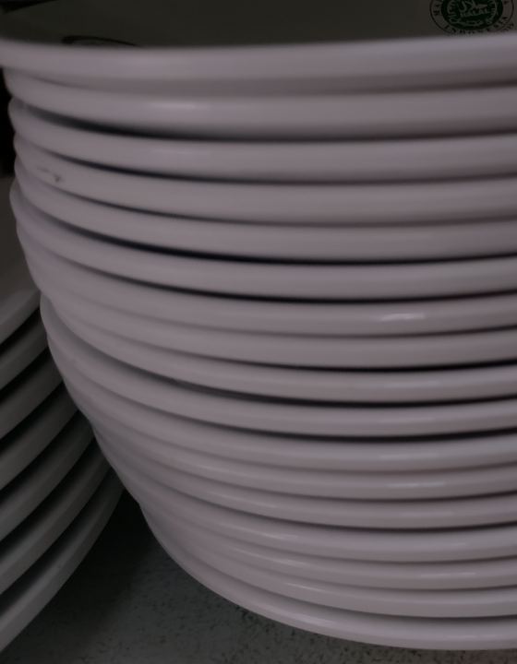
Product overview :
Unique
First to market
Only product specifically dedicated to the restaurant industry
First beautifully designed product that's both stylish and functional​.
Tested
Authentic
Conducted test with different groups of people from different area
Designed with the help and input of restaurant and service workers in the field ​

Slide 8

Product benefits
Simple and efficient to use​
Quick customer service assistance

Slide 9

project overview

Slide 10
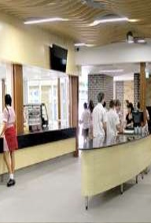
Overview
We have used visual studio tools for our project with visual Basic. The program has a database connection(SQL). Our main class is Canteen class, and this class has some public functions like show, allItems, soldItems, addNewItem, editItem, deleteItem, searchById, searchByName, checkQuantity, addNewSale.

Slide 11
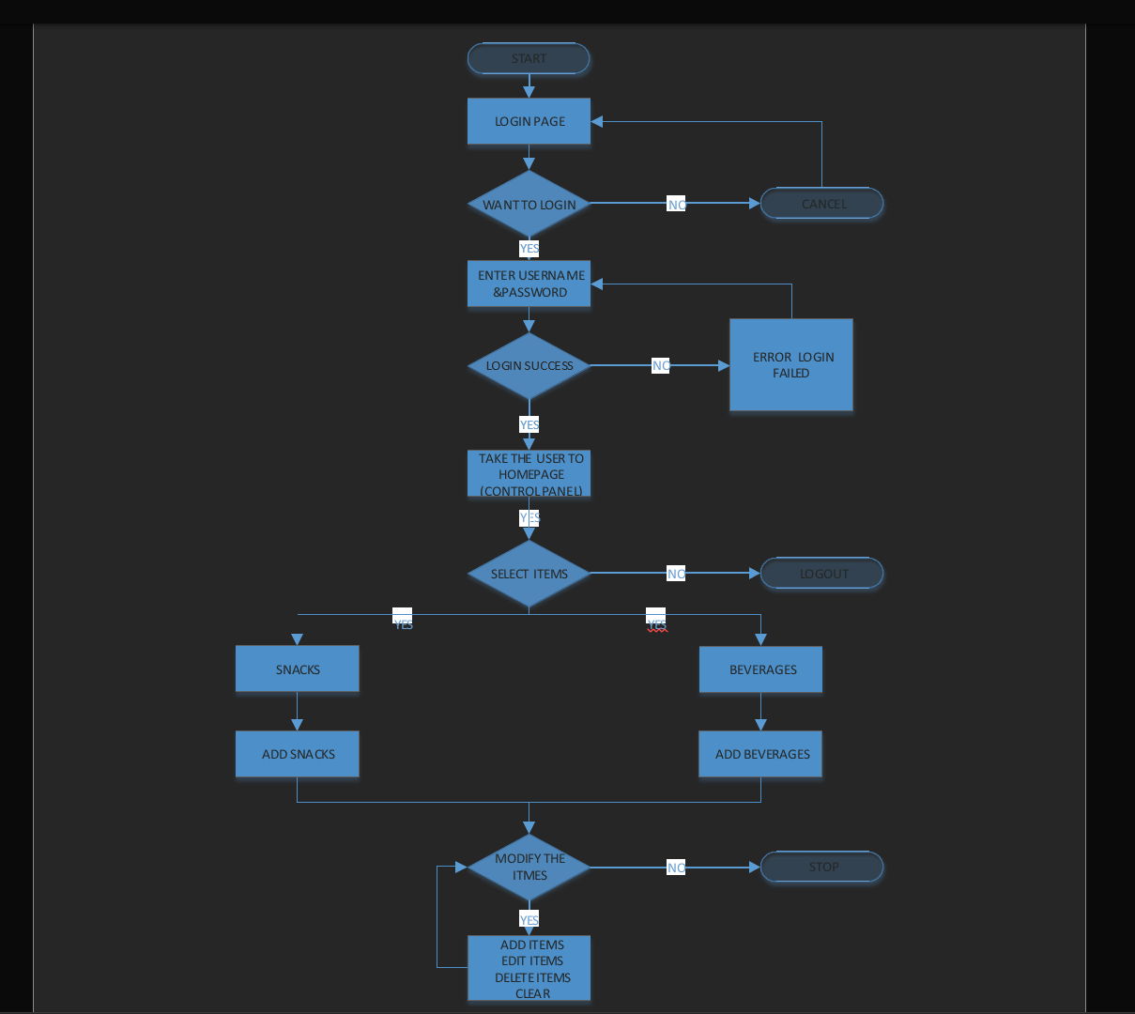
Flow Chart

Slide 12
ALGORITHM
Admin logins to the system and manage all the functionalities of Canteen Management System
Admin can add, edit, delete and view the records of Food, Category, Canteen Employee, Sales
Admin can manage all the details of Item, Customer, Canteen Record
Admin can also generate reports of Food, Item, Category, Customer, Canteen Employee, Canteen Record
Admin can search the details of Item, Canteen Employee, Canteen Record
Admin can apply different level of filters on report of Food, Customer, Canteen Employee .
Admin can track the detailed information of Item, Category, Customer,, Canteen Employee
User can order food.
User can delete the item.
User accept the bill of food ordered
User can keep track of his/her record.

Slide 13
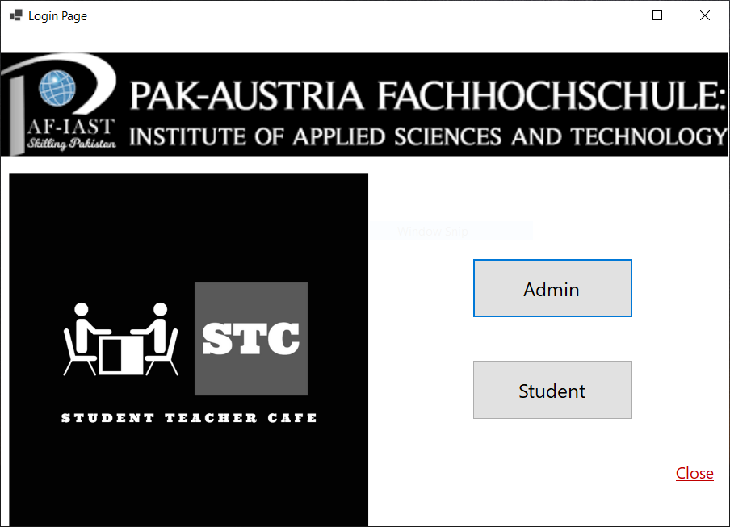
Starting Window

Slide 14
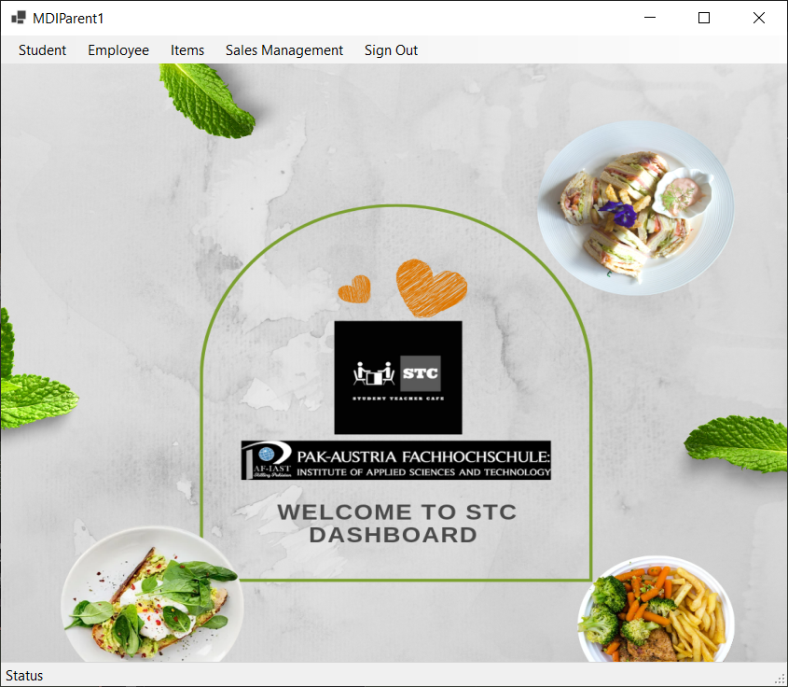
Admin View

Slide 15
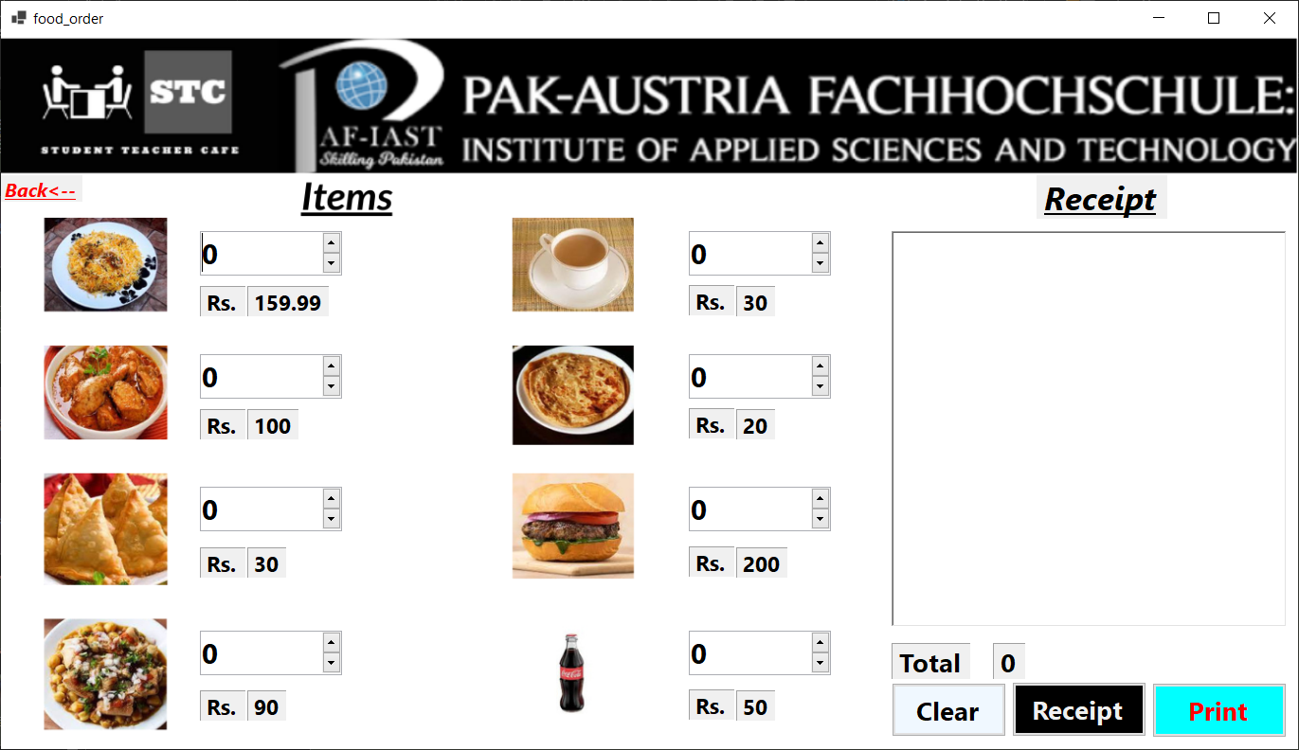
Main Window

Slide 16

Summary
At PAF-IAST, we believe in giving 110%. By improving our performance, we helped each other member during the work. We thrive because of our knowledge and a great team behind our product. As our Leader Umar Zaib says, "Efficiencies will come from proactively transforming how we do business."​

Slide 17

Thank You
2b |! 2b​​
Than

